Slide 1
JEM-X Gain Calibration
Xe line analysis and IC tables
Carol Anne Oxborrow

Slide 2
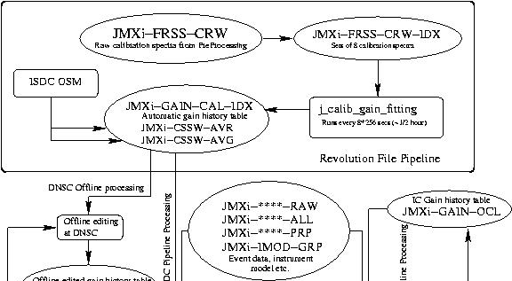
ISDC Gain History Table

Slide 3
Gain Correction

Slide 4
Xe line position: Good examples

Slide 5
Xe line position: Not-so-good examples

Slide 6
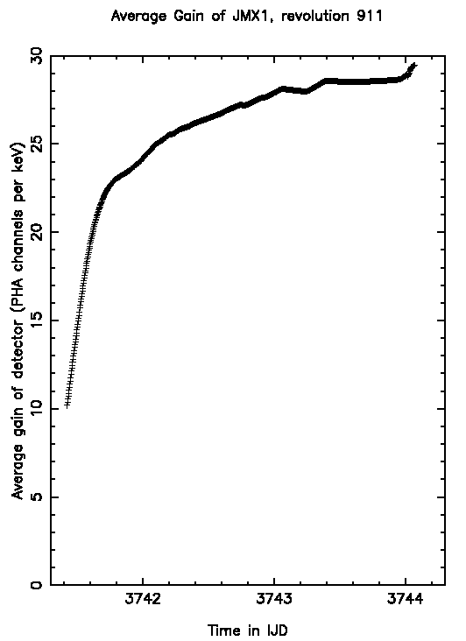
Non-linear Effect

Slide 7
IC tables vs. non-corrected GainHistory tables

Slide 8
Bad Things Made Good with IC Tables
Poor gain smoothing in j_cor_gain
very rare with v8.03
Heavily grey-filtered gain history tables
Zeros produced by j_calib_gain_fitting
Happens with strong sources especially SCO X-1 and Crab
Generally low Xe level
due to high gain and temperature dependence
Due to microstrip plate aging
Continues to increase with age
Non-linear gain effect
Due to varying temperature/gain relationship
Continues to increase with age
Unusual events
Seen only a few times during mission
Plate charging

Slide 9
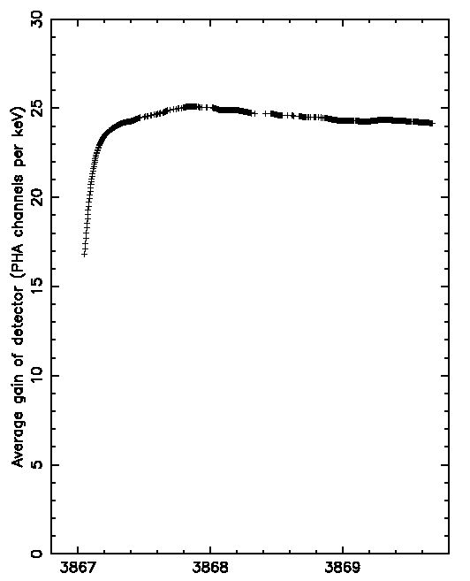
Rare Events: Revolution 953, JEM-X2

Slide 10
Rare Events: JEM-X1 Revolution 332

Slide 11
Calibration Sources

